Slide 1

A Case Study: Disappearing Printer INk
Presented by Michael Yamma &
Brian Molloy
© 2021 Office of the City Auditor , ATX

Slide 2
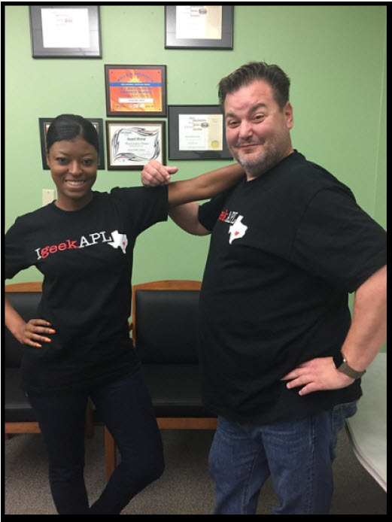
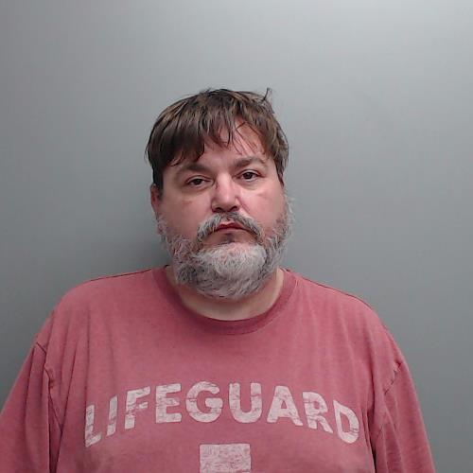
The Story of Fraud and Waste at the Austin Public Library
How did this happen
Redacted to protect the innocent
APL Flickr
Hays County Sheriff’s Office

Slide 3
Background:
Austin, OCA, & APL
Why this case matters
Case study: Disappearing ink
Working with law enforcement
Reporting: the right thing to write
Prevention and lessons learned
1
4
2
5
3
6
All in just 80 minutes!

Slide 4
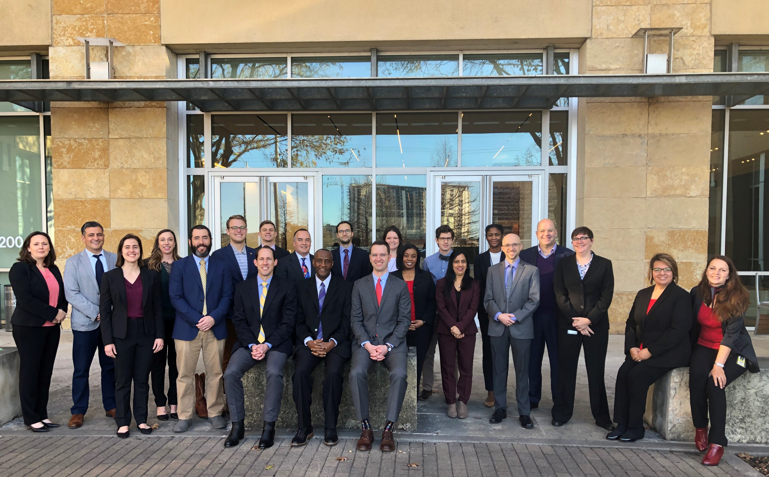



Background
Office of the City Auditor
Integrity Unit
300+ allegations/yr
Investigations publicly available
APL Printer Needs
Xerox - public facing
HP – staff facing
City of Austin
15K employees
1700 credit cards
APL -$50.4M budget
Allegation:
March 2019

Slide 5
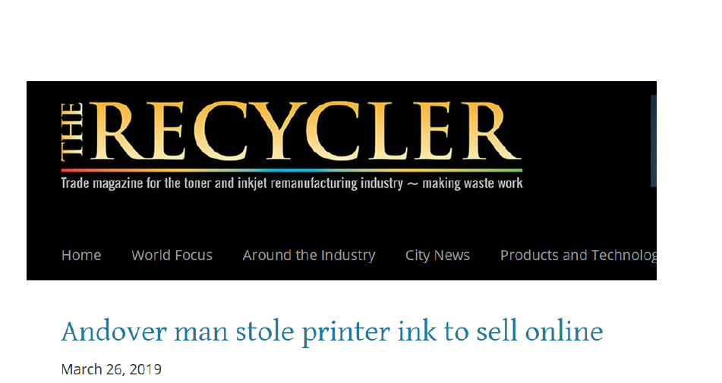
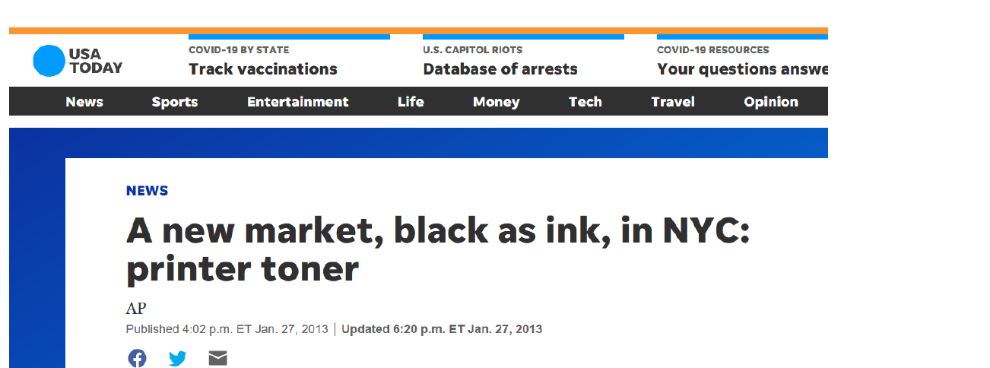
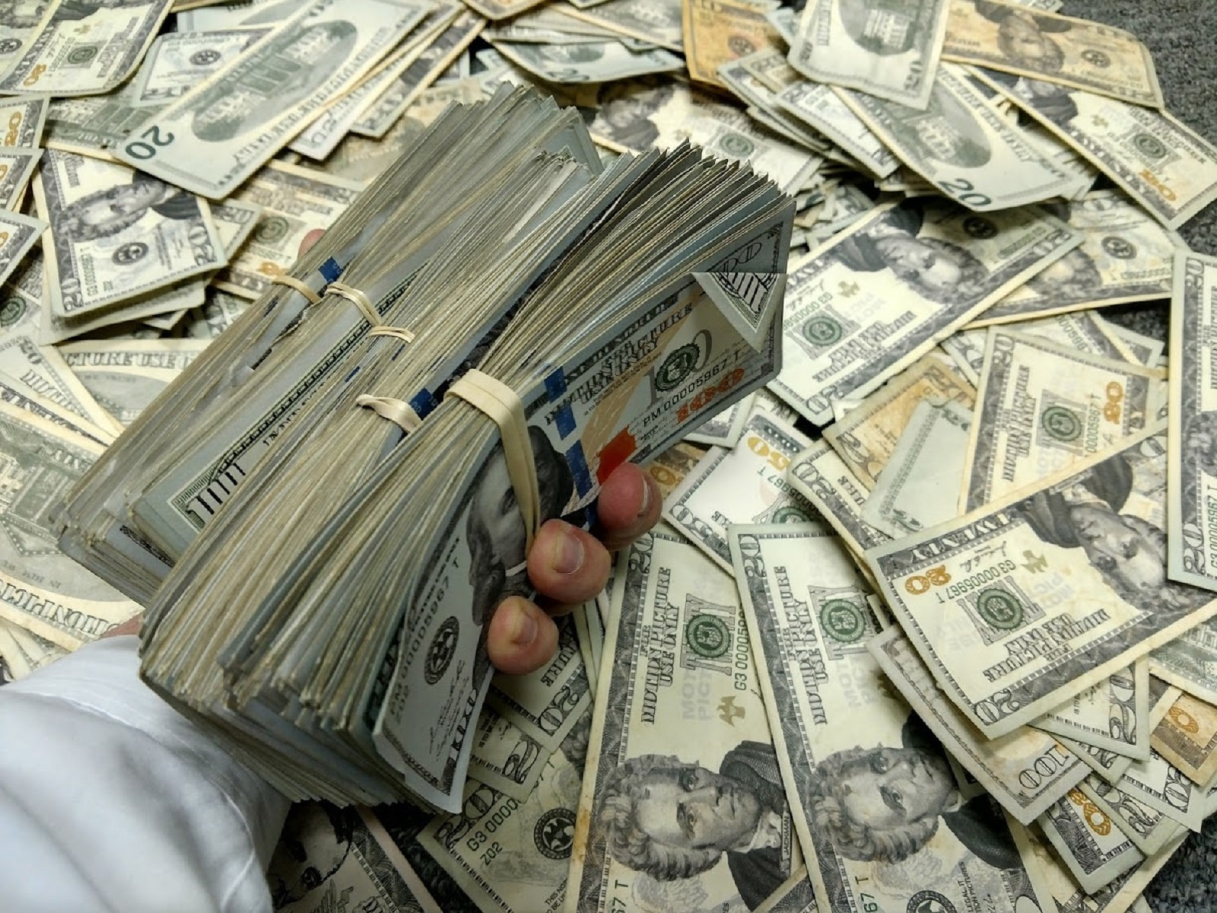
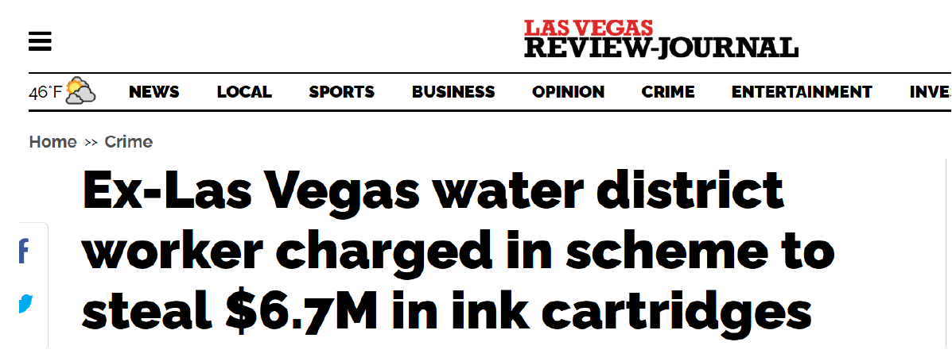
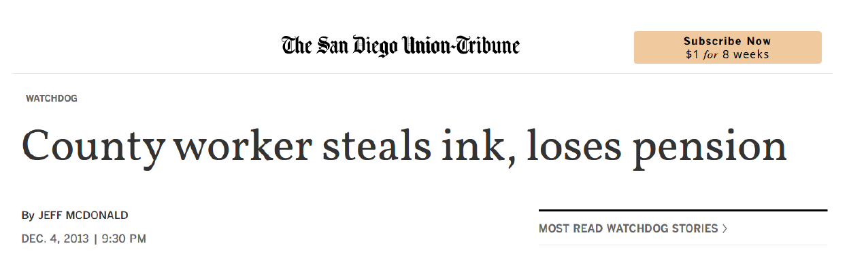
Why this matters – impact & applicability
$1.3+ million
1 bad actor
Austin is not alone
Notes:
Las vegas, san diego, phildelphia, small biz in Michigan, xerox in florida, NYC hospital, andover UK

Slide 6
Anonymous Allegation
March 2019
Library employee stealing printer toner and selling it
Notes:
Tell story of the allegation we initially received and what we did that led to our public report and this webinar
Not much to go on other than a name and where the employee works

Slide 7
Initial Background Work
Background of subject
01
Review purchase records – small scope
02
Interview with supervisor
03
Learn about systems in place
Notes:
Background
Employee of City?
What’s his job?
Access to procards? – note he had access to like 10
Review purchase records
Limited time period to determine if whited was buying toner
We found that he was making purchases of toner, but didn’t have a good sense of whether it was fraud at that point
So we decided to…
Interview with Supervisor
Get better sense of operations – how were purchases being made?
What needs do they have for office supplies? How many printers are there etc.
We weren’t able to learn too much in this interview
Very surprising allegation…Whited very well-liked member of APL staff
Issue with arriving early

Slide 8
Main investigation
Work in Financial Records
Forensic Research
Open-source Information
Notes:
Use open sources like Facebook and usernames found on laptop to look for other accounts like eBay

Slide 9
Purchase Approvals
Card Holder
Supervisor Approval
Accountant-level Review
Notes:
one other important bit of information - Whited was an account holder as well as Accountant – red flag for segregation of duties

Slide 10
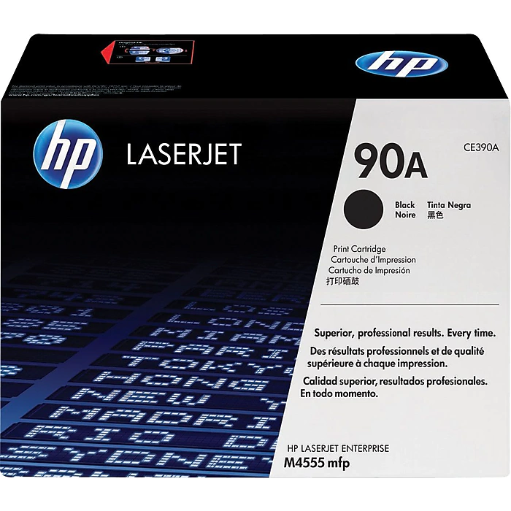
Financials
https://store.hp.com/us/en/pdp/hp-90x-high-yield-black-original-laserjet-toner-cartridge
Notes:
Expand search of toner purchase records
as I mentioned he had access to roughly 10 procards at the time
reviewed records going back to 2007 (when he got a procard)
chart illustrates well the idea that fraud starts small and grows over time
Ultimately we found that during his time with APL whited spend in the neighborhood of 1.5M on toner.
Spent roughly 5-8x what the entire City spent in various years
In addition to toner we started noticing other suspicious transactions made by whited…for example (next slide)

Slide 11
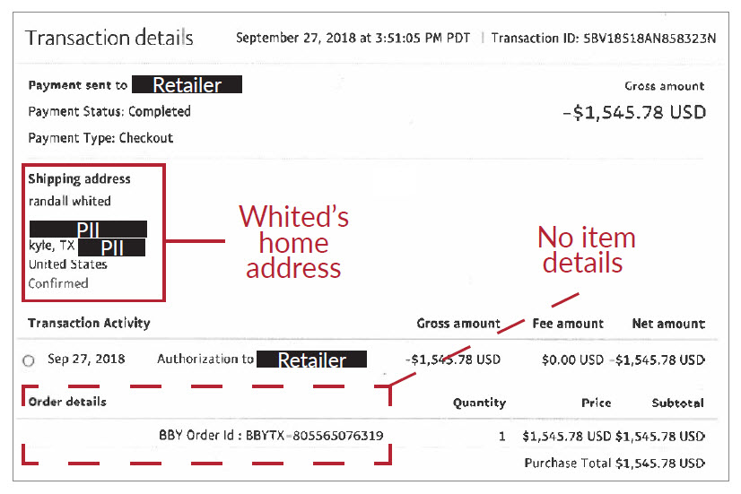
Notes:
This is a receipt submitted by Whited that was approved by his supervisor for a $1500 purchase. Brian, do you know what this purchase is for?
No itemized details. Also notice the shipping address. Again, this was approved without even being questioned.
We’ll come back to this purchase in a few minutes, but let’s shift a bit and focus on...forensics

Slide 12
Forensics
City Auditor Access
Emails
Electronic documents & browser history
Notes:
City Auditor has access to everything City-related
including records, programs, and staff
We decided to pull a forensic search of Whited’s City computer…
Emails – personal information and various documents related to Whited’s finances (usernames, passwords for various entities including banks, credit cards, and retail vendors)
I will circle back to how we used this info shortly
Documents containing shipping information…the docs showed Whited shipping dozens of items to an address in florida…more on this later
Browser history – we reviewed the websites that Whited visited on his city computer and found multiple hits to toner reseller sites.

Slide 13
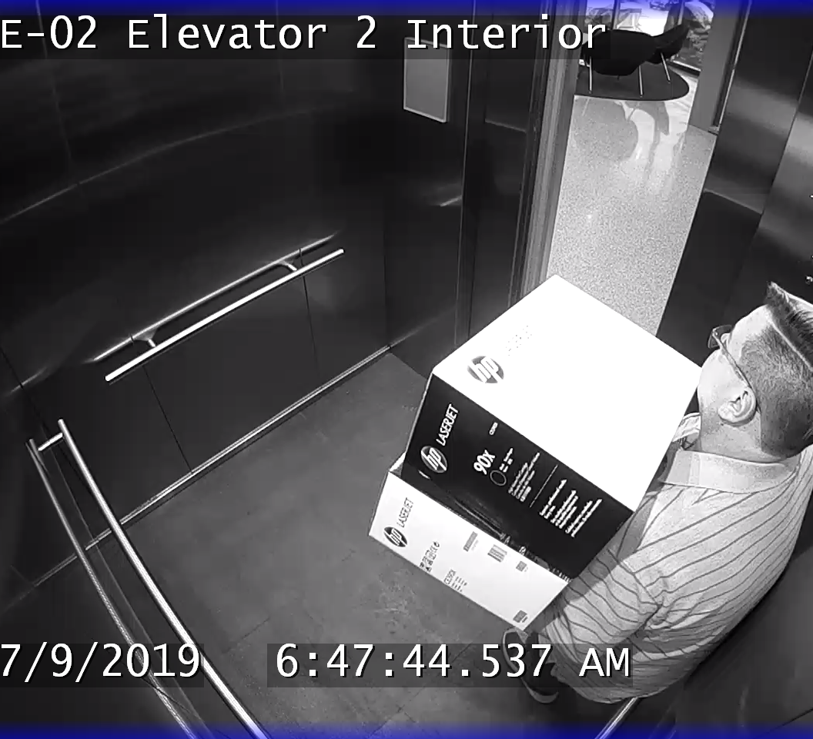
Badge and Camera Data
Notes:
So…we’ve discussed the financial records that show Whited purchasing a high volume of toner
We’ve looked at some of the forensics we pulled that showed whited possibly selling items
But there was still no concrete evidence of him taking toner…so here’s where we come back to access to records
Discuss badge swipe data and then pulling camera footage

Slide 14
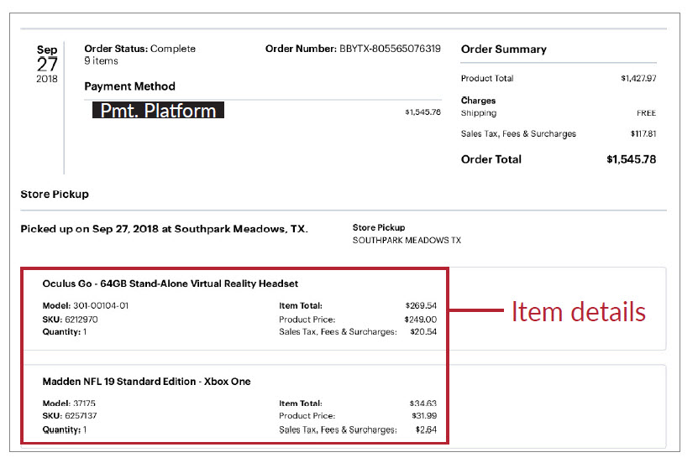
Open Sources
Online classifieds and e-commerce
Social media
Merchant records
Notes:
So what’s he doing with all this toner?
That brings us to open sources -
Use info from forensic pull to find other accounts (ebay etc) – Circle back to shipping spreadsheet – turns out the address was to an online toner reseller
Also searched social media sites and found him selling items on FB marketplace
And lastly – to close the loop on the earlier transaction I showed you…
Best buy point – transaction numbers from paypal records

Slide 15
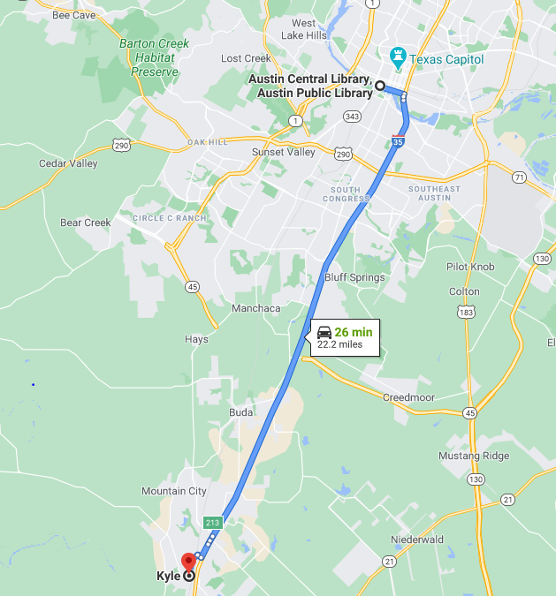
But wait there’s more…fraud
Lockers and home shipments
Non-City purchases
Notes:
So as I’ve mentioned, in addition to toner we also found other suspicious transactions
A couple of the main things we found include:
Whited using his procard at online vendors and having items shipped directly to his house or lockers
And even more obvious were some transactions that had nothing to do with City needs like a robot vacuum or a drone

Slide 16

What does it all mean
Established high volume of purchases – now what
How much toner
Estimates
Manufacturer data
Notes:
Interview branches to understand usage and storage quantities
In addition to speaking with branches we…
Pulled Printer records/amount of printers
Total printer output / toner output estimates = need
ESTIMATES BETWEEN 45 AND 150K not the 1.5M they spent

Slide 17
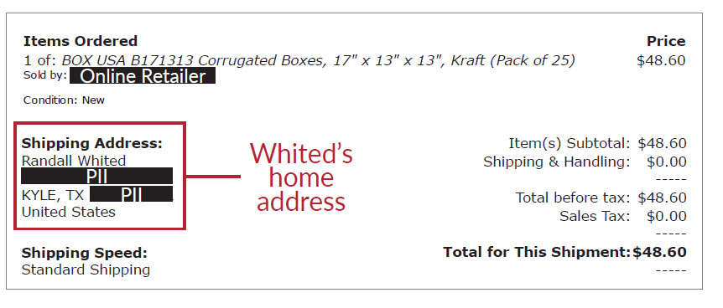
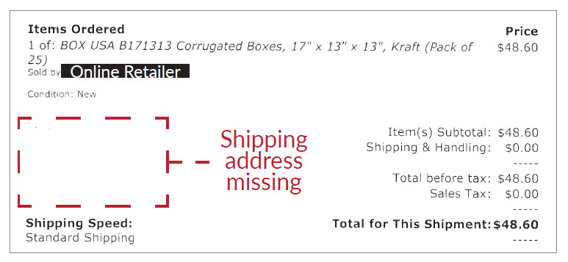
Waste
Expenditures versus Usage
Interviews with APL staff
Budget
Notes:
Obvious that’s a huge disparity which brings us to the other focus of our investigation - waste
There were a few things that we noted in our investigation that allowed whited to not only get away with this, but do it for almost a decade.
I’ve broken the issues down by area within the library. Starting with…
Executives – laxed oversight of expenditures and budget overages
Finance – poor reviews/oversight – example is whited supervisors not reviewing shipping information
Warehouse - No controls for receiving or shipping
IT purchases not going through IT (who has inventory)

Slide 18
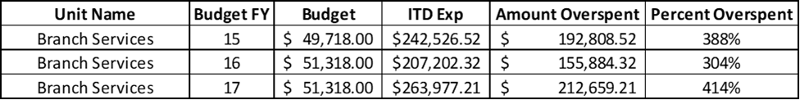
Waste
Budget for Office Supplies

Slide 19
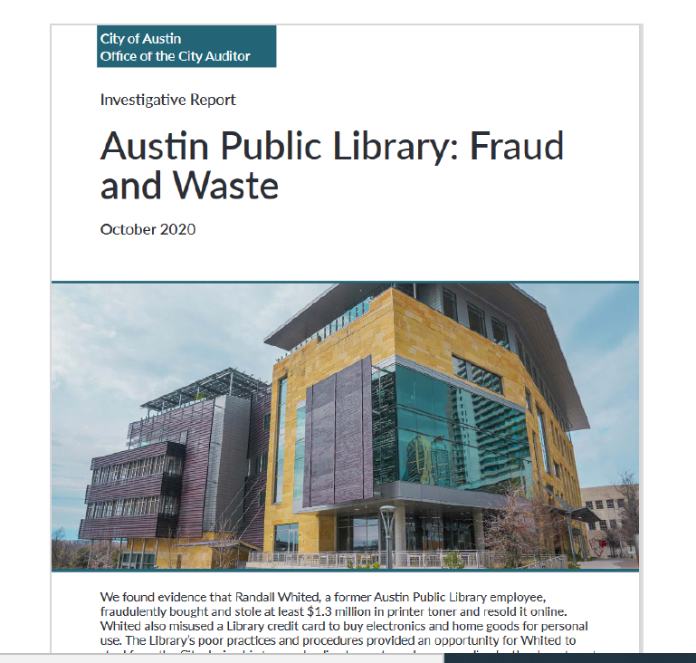
Reporting
Report released in October 2020
Keeping APD apprised of our progress
Preparing stakeholders in the City
Attention after reporting
APL fraud & waste report

Slide 20
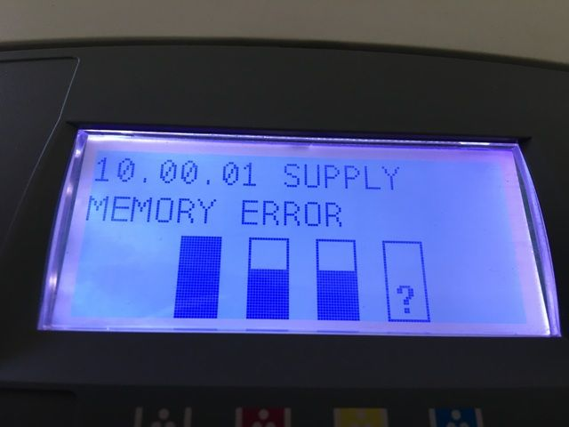

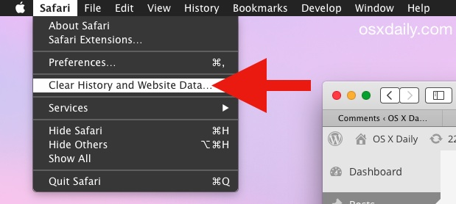
Testing: Is my ink disappearing?
Printer memory analysis
Pattern in toner purchases
  Amounts of toner purchased
  Amounts of paper purchased
  Comparisons to other purchasers
Browser histories
Outlier behaviors/responsibilities: holding multiple roles, assigned multiple procards, unusual requests

Slide 21
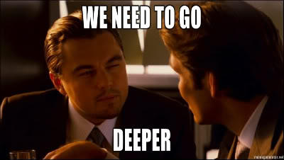

Lessons learned
Classic: segregation of duties
purchase/receive
purchase/approve
single point of contact
(2) Empower reviewers & approvers
(3) Go beyond interviews
(4) Keep an open mind about evidence
Notes:
Segregation of duties works for a reason. The same person should not be allowed to order and receive items. Just as importantly, employees should not be able to approve their own purchases. When investigating, auditors should look for individuals who hold dual roles like these that could be exploited.
Empower reviewers. Purchase approvers or reviewers in an organization should know they are more than just a rubber stamp. They should be trained on the importance of their role and their ability to say “yes” or “no” in the approval process. Additionally, auditors should make sure these individuals have appropriate operational knowledge about the area of the organization for which they approve purchases so they understand what needs are real. When investigating, auditors should listen for witnesses who say they “just trust” someone to take care of things.
Don’t stop at witness testimony. In this investigation, like many, witnesses were interviewed to learn more about library operations before auditors knew what records or other evidence might be useful. The initial witnesses shot down the idea that Whited might be defrauding the City. He was a “great employee” who had been in the job for years and knew what the library needed. Had auditors stopped the investigation after witnesses contradicted the allegation, he would still be defrauding the library today.
Keep an open mind about evidence. Auditors never know what they are going to find during an investigation or where evidence will come from. When this investigation started, no one on the audit team knew much about printers or printer usage. They worked with IT staff to review printer manufacturer information and learned that most printers have enough memory to keep a record of everything they ever printed. By combining the printed page records with manufacturer toner data, they were able to calculate how much toner the library needed over a given time period. That was a huge step in the investigation and allowed auditors to determine how much excess toner Whited was buying and stealing.

Slide 22
Questions?

