Slide 1

Commonwealth of Virginia
Recent Audit & Inspection Projects at OSIG
Virginia Local Government Auditors Association
Spring Conference 2021
Mike Taylor, OSIG Deputy Inspector General
Camille Breland, OSIG Advanced Senior Auditor/Project Manager
June 16, 2021
Michael C. Westfall
State Inspector General
Office of the State Inspector General

Slide 2
AGENDA
DMME Diversity Recruitment and Hiring
Unannounced Inspections
Mortality Review
College Campus Safety (Clery Act)
Drinking Water Regulation
Conservation Easements
Charitable Gaming

Slide 3

DMME Diversity Recruitment and Hiring
Request received by OSIG:
Driven by Natural Resources Law Enforcement Diversity audit.
ONE Virginia Plan:
Governor Northam appoints Virginia’s first Chief Diversity Officer.
Office of Diversity Equity and Inclusion codified in 2021.

Slide 4
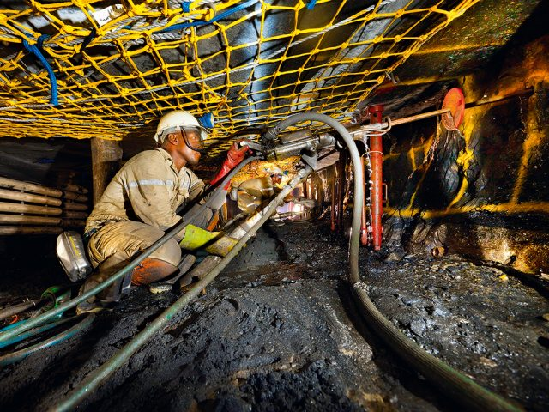


DMME Diversity Recruitment and Hiring
What Does DMME Do?

Slide 5
DMME Diversity Recruitment and Hiring
TENTATIVE OBJECTIVES
Are current diversity recruitment strategies consistent with similar- sized and type agencies, and are those strategies effective in increasing the number of diverse candidates who apply for positions?
Are the application screening, testing (if applicable) and interview processes current and/or align with the true requirements of the job that would not exclude diverse candidates from being offered positions?
Does DMME management support an inclusive work environment and provide employee training to promote a culture free of discrimination towards diverse employees?
Are current DMME outreach and/or educational programs (if applicable) designed to offer opportunities to all Virginians and promote interest in mining, minerals and energy programs?

Slide 6
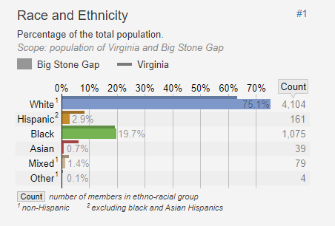
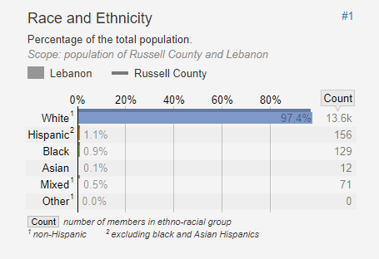


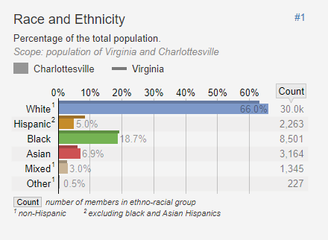
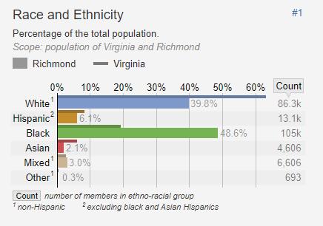


DMME Diversity Recruitment and Hiring
PLANNING

Slide 7
DMME Diversity Recruitment and Hiring
Potential Audit Methodologies
SURVEY
INDUSTRY ANALYSIS
ONSITES
HIRING PROCESS ANALYSIS
RECRUITMENT ANALYSIS
INTERVIEWS

Slide 8
DMME Diversity Recruitment and Hiring
Anticipated Challenges
“Why is OSIG here?”
DMME diversity is reflective of the industry.
Duplication of effort.

Slide 9
DMME Diversity Recruitment and Hiring
Resources
Federal, state and local statistics.
Industry data and information.
Affinity groups.
DEI exemplars and subject matter experts.
Prior audits.

Slide 10

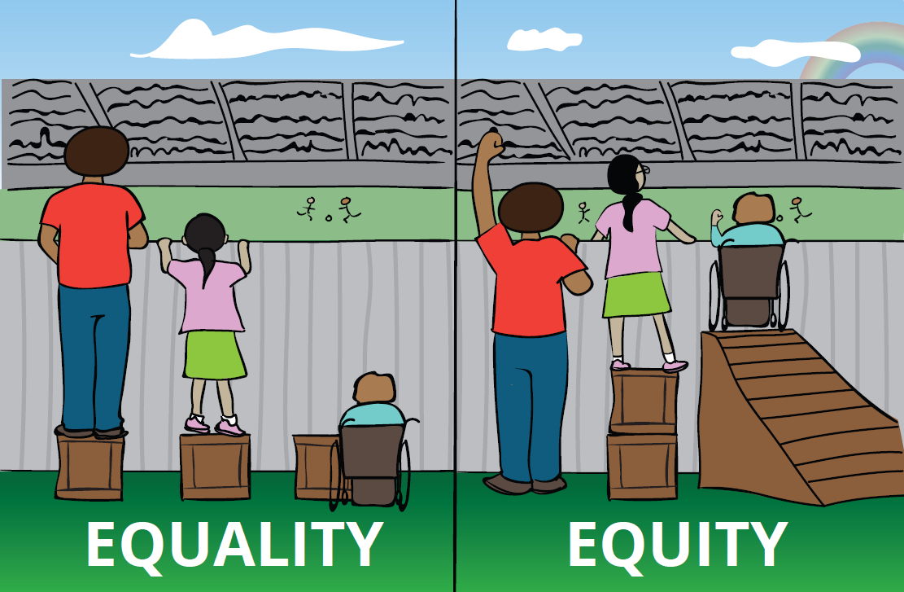
DMME Diversity Recruitment and Hiring
Lessons Learned
NRLE challenges apply to other professions.
Challenge of diversity is not just about diversity. It encapsulates other factors such as leadership, culture and engagement.
Equality vs. equity.
Unconscious bias in diversity:
  Need for education in addition to change.
Ability to look from a different viewpoint.
www.osig.viginia.gov/reports

Slide 11

DMME Diversity Recruitment and Hiring
What The Past Has Taught Us

Slide 12
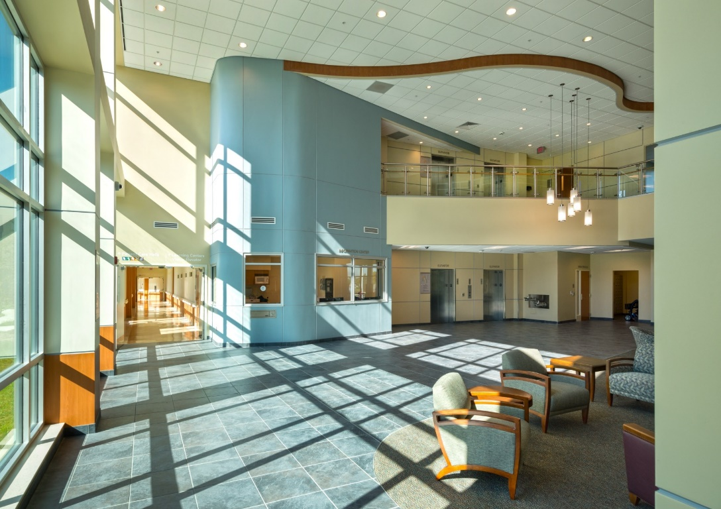
Unannounced Inspections of
Behavioral Health Facilities
Impact of COVID on Inspections Process:
  Timing.
  Objectives.
  Methodology.

Slide 13
Unannounced Inspections of
Behavioral Health Facilities
Preliminary results:
Corrective actions taken.
Progress being made.
Facility staff aware of COVID protocols.
Video observations showed staff were following proper procedures.

Slide 14
Unannounced Inspections of
Behavioral Health Facilities

Slide 15

Unannounced Inspections of
Behavioral Health Facilities
Impact on our report:
Could conclude on follow-up actions.
Could conclude on results from first inspection.
No conclusion on the remaining facilities.
Impact on future work:
May have different objectives for each facility.
May inspect all facilities at the same time.
May make multiple inspections at some or all facilities.
May implement a management representation letter.

Slide 16
Mortality Review in
Behavioral Health Facilities
First review – July 2020 report:
Focused on policies and procedures.
Found lack of consistency among facilities.
Found lack of oversight from central office.
Found existing policies not reviewed periodically.

Slide 17
Mortality Review in
Behavioral Health Facilities
Second review – March 2021 report:
Focused on death cases.
Found incomplete documentation.
Found facilities were missing documentation.
Found protocols were not followed.
Will be an ongoing project.

Slide 18
Clery Act
The Clery Act requires all colleges and universities that participate in federal financial aid programs (Title IV) to provide students and their families with accurate, complete and timely information about crime and campus safety so that they can make informed decisions.

Slide 19
Clery Act
Potential audit objectives:
To determine whether higher education institutions accurately reported crime statistics and published other relevant security and safety-related information required by the Clery Act.
Specific underlying objectives TBD after planning phase.

Slide 20

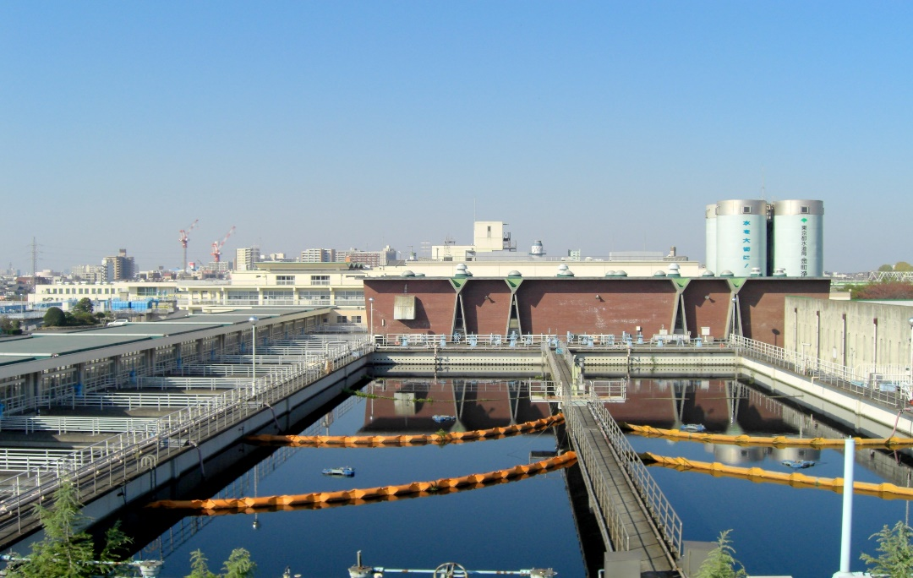

Office of Drinking Water
Drinking Water Regulation

Slide 21

Office of Drinking Water
Drinking Water Regulation
OSIG FY 2019
Annual Audit Plan

Slide 22
Office of Drinking Water
Drinking Water Regulation
    OBJECTIVES
Determine whether ODW effectively monitors public water systems (PWSs) in Virginia to ensure safe drinking water by continuous monitoring and water sample testing for various identified contaminates.
Determine whether ODW effectively monitors PWSs in Virginia to ensure safe drinking water by conducting sanitary surveys (i.e., on-site inspections) of PWSs.
Determine if ODW conducts systematic reviews of water testing data in the State Drinking Water Information System and if staff review finds indications of problems that may develop over time and questionable results that could indicate mistakes or fraud.
Examine violations issued from 2015 through 2019 to assess the effectiveness of ODW monitoring and enforcement efforts.
Determine if formal enforcement actions have been taken by ODW against PWSs that incurred significant violations for maximum containment level treatment technique or monitoring and/or reporting requirements.
Determine if ODW is assessing or collecting civil penalties for drinking water violations.

Slide 23
Office of Drinking Water
Drinking Water Regulation
    ROLLING UP OUR SLEEVES
    Planning Highlights
“Data Rich” audit – federal and state.
Performance measures.
New leadership.

Slide 24
Office of Drinking Water
Drinking Water Regulation
DIGGING IN
FIELDWORK HIGHLIGHTS
Sampling
  Sanitary surveys.
  Water monitoring and sampling.

Slide 25
Office of Drinking Water
Drinking Water Regulation
DIGGING IN
FIELDWORK HIGHLIGHTS
Formal vs. Informal Enforcement
  Escalation practices.
  Violations.
  Administrative orders.

Slide 26
Office of Drinking Water
Drinking Water Regulation
DIGGING IN
FIELDWORK HIGHLIGHTS
Fines and Penalties
  Evaluation of legal proceedings.
  Assessment of civil penalties.

Slide 27

Office of Drinking Water
Drinking Water Regulation
Reporting Out
Interim Report
  ODW deadline for General Assembly study.
  Less formal, but sent to Governor with a copy to the State Health Commissioner.

Slide 28
Office of Drinking Water
Drinking Water Regulation
Reporting Out
Final Report
In the final draft phase.
Nine findings and recommendations.
ODW agreed with all the recommendations.

Slide 29
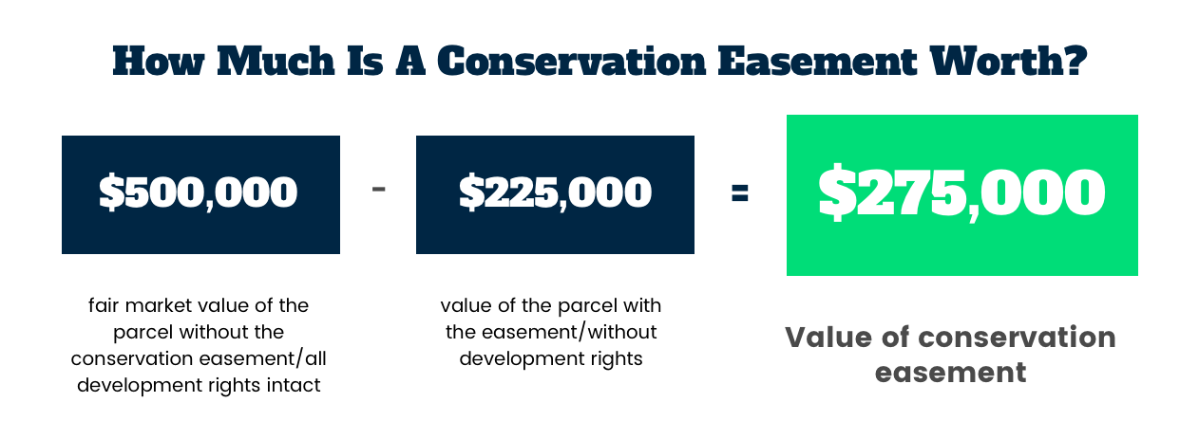
Conservation Easements
What are they?
How do they work?

Slide 30

Conservation Easements
Why are we auditing conservation easements?
How did COVID impact the audit?
Why might this matter to you?

Slide 31
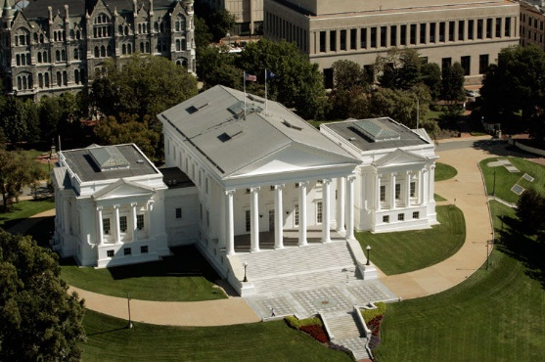
Charitable Gaming
How it made the plan.

Slide 32
Charitable Gaming
Review Objectives - OSIG shall review the regulatory structure of charitable gaming in Virginia, to include, at a minimum:
Current permitting requirements and exemptions.
Net revenue dedicated to charitable activities and which types of gaming revenue is excluded from this calculation.
Charitable gaming occurring in remote locations not located in the same jurisdiction as the registered address of the charitable organization.
Enforcement of the “social quarters" and “members and guests" limitation.
The structure of the Charitable Gaming Board including any changes needed to prevent conflicts of interest.
The adequacy of enforcement and resources dedicated to oversight activities of the Office of Charitable and Regulatory Programs.
Whether regulation of charitable gaming would be more appropriately vested with the Virginia Lottery.

Slide 33

Charitable Gaming
Impact on the office and how
we will make it happen.

Slide 34

Questions and Contact Information
F. Michael Taylor, CPA, CIA
  OSIG Deputy Inspector General for Audit & Inspections
  804-625-3267
  mike.taylor@osig.Virginia.gov
Camille A. Breland, MAcc, CIGA
  OSIG Advanced Senior Auditor/Project Manager
  804-418-4845
  camille.breland@osig.virginia.gov
OSIG.VIRGINIA.GOV

